Slide 1
From polygons to polyhedra and beyond
St Paul’s Geometry Masterclass I

Slide 2
Who are we?
Mairi Walker
Final year maths PhD student at The Open University
Studying links between geometry and numbers
Also interested in the history of maths
David Martí Pete
Second year PhD student at The Open University
Studying complex dynamics

Slide 3
What are we doing?
We have organised a series of workshops to show you what it’s like to study maths at university. We’ve based the themes on aspects of our own research, and some of our favourite topics!
The workshops are:
From polygons to polyhedra and beyond
Fractals: Friends or foe?
Mapping the world

Slide 4
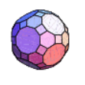
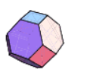
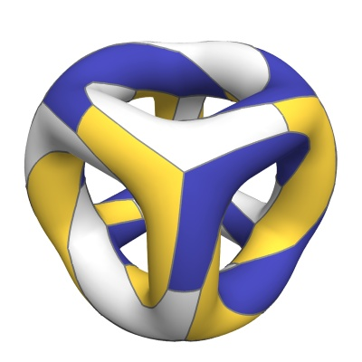
From polygons to polyhedra and beyond

Slide 5
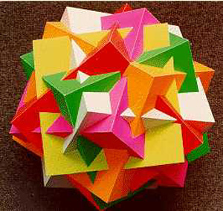
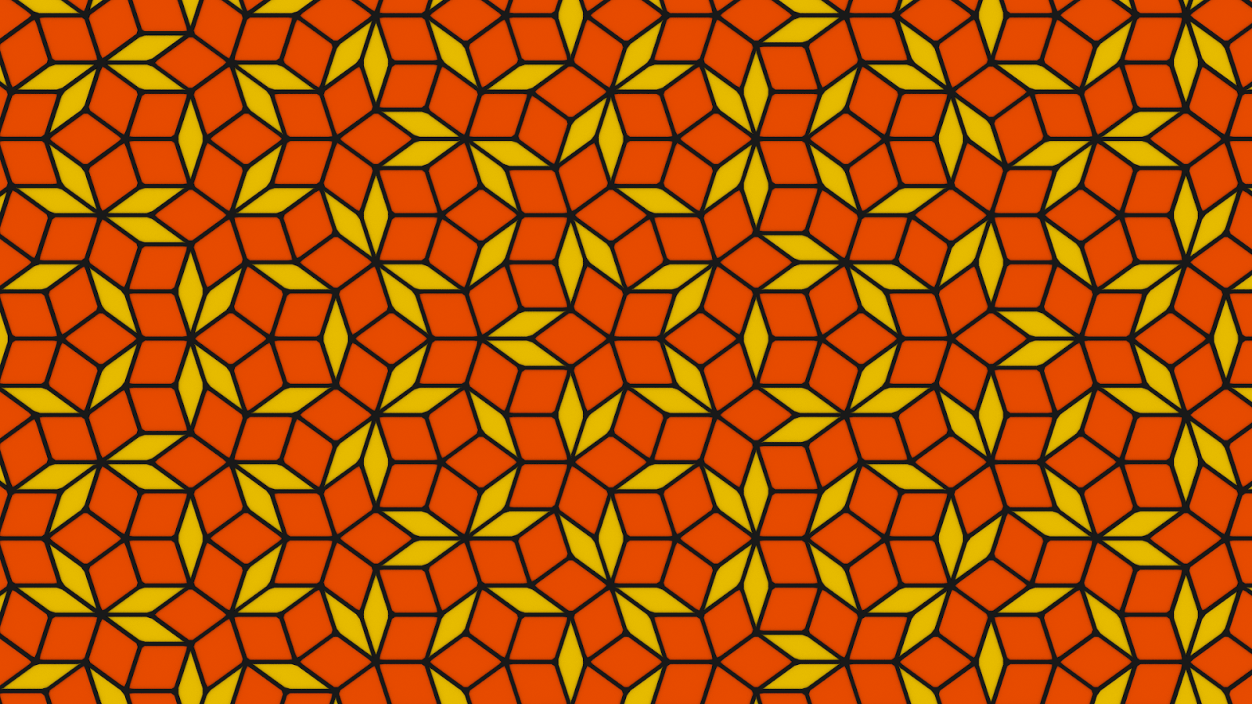
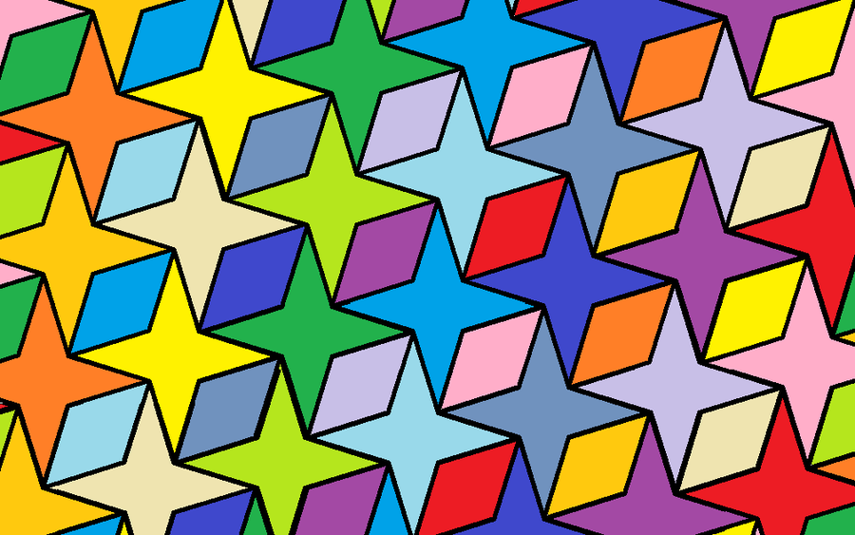
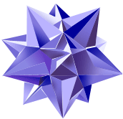
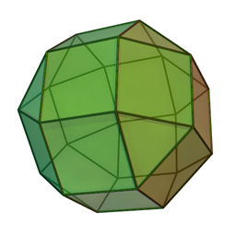
Joining polygons
Polygons can be joined together to make all different kinds of shapes.

Slide 6
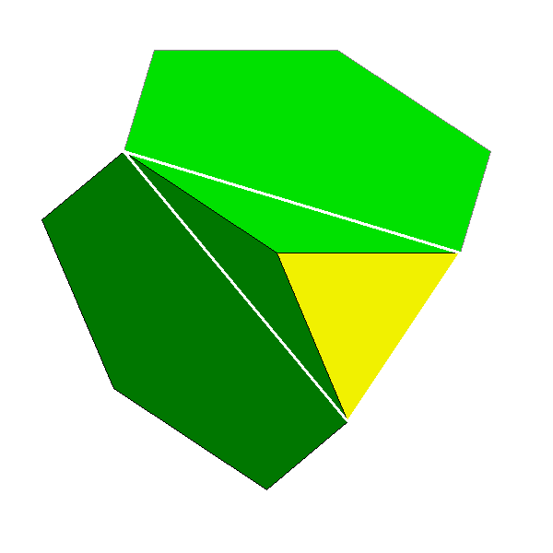
From polygons to polyhedra
To keep things simple we will construct polyhedra:
Out of regular polygons
So that the same arrangement of faces can be found at each vertex.
A recipe tells you which faces to join at each vertex i.e. (3,6,6) means place a triangle followed by two hexagons (in a clockwise order) at each vertex.

Slide 7
From polygons to polyhedra
Recipe | Polyhedra? | Tessellation? | Nothing?
(6,6,6)
(3,6,6)
(4,6,8)
(3,6,8)
(3,3,4,3,4)
(4,4,4)
(3,3,3,3,3)
(4,5,5)
(4,8,8)

Slide 8
A mathematical problem
Polyhedra have been studied by mathematicians for thousands of years.
How can we classify them?
How many of each type are there?
How do we know we have found them all?
We will try to answer these questions for some of the polyhedra we’ve found today.

Slide 9
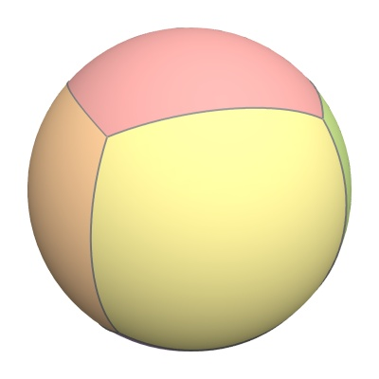
Polyhedra: tessellations of a sphere
We can view polyhedra as tessellations of a sphere.
Euler’s formula says that for any tessellation of a sphere, with V vertices, E edges and F faces,
V-E+F=2

Slide 10
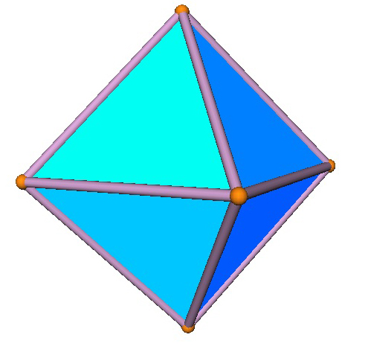
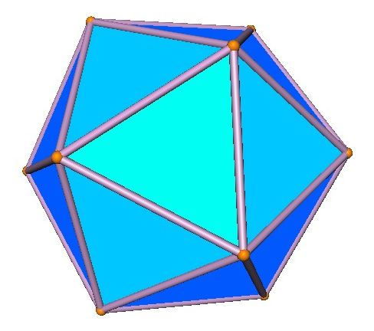
The Platonic solids
The Platonic solids are those polyhedra where:
Every face has the same number of edges
The same number of edges meet at each vertex.
Examples include the octahedron and the icosahedron.
How many are there in total?

Slide 11
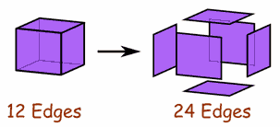
Proof I
Say that every face has p edges/vertices, and q faces meet at each vertex. We expand our polygon by cutting it along each edge. This doubles the number of edges to get 2E edges.
The new number of edges is also the number of faces times the number of edges per face: pF. So pF=2E.

Slide 12
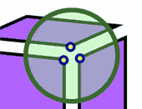
Proof II
The number of vertices in the expanded shape is equal to the number of edges in it, so 2E.
The number of vertices in the expanded shape is also equal to the number of vertices in the original shape times the number of faces meeting at each vertex: qV. So 2E=qV.

Slide 13
Proof III
V-E+F=2 and pF=2E=qV
$$\frac{2E}{q}−E+\frac{2E}{p}=2$$
So
$$\frac{1}{q}−\frac{1}{2}+\frac{1}{p}=\frac{1}{E}$$
So
$$\frac{1}{q}+\frac{1}{p}=\frac{1}{E}+\frac{1}{2}>\frac{1}{2}$$

Slide 14
The Platonic solids
$$\frac{1}{q}+\frac{1}{p}>\frac{1}{2}$$
How many possibilities for p and q are there?
There are only 5!
{3,3}, {4,3}, {3,4}, {5,3}, {3,5}
(tetrahedron, octahedron, cube, icosahedron, dodecahedron)

Slide 15
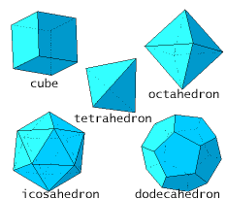
The Platonic solids
We found all of the Platonic solids earlier!

Slide 16
Beyond polyhedra
When mathematicians solve one problem they often try to make it more general.
Mathematicians have studied polyhedra on spheres for thousands of years. But what about polyhedra cut out from other 3D shapes?
What other shapes might work? The flat plane won’t do! We need to look for mathematical surfaces.

Slide 17
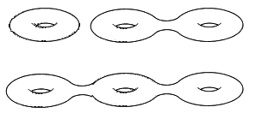
Surfaces
A surface is a shape that when you zoom in really close, it looks flat. A sphere is a surface. A jagged mountain top isn’t as it has points!
Actually, every single surface, once it’s been stretched or squashed a bit, will look like one of these:
The number of holes (0,1,2,3,…) is called the genus of the surface.

Slide 18
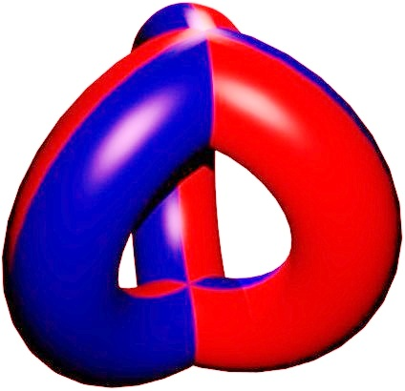
Maps on surfaces
Just as we drew tessellations on the sphere to represent polyhedra, we can draw tessellations on other surfaces. We call these mathematical maps.

Slide 19
Generalising the Platonic solids
The Platonic solids are maps on a sphere for which every face has p edges/vertices and q faces meet. We want our generalisation to have this property too! We call them {p,q}-patterns:
A {p,q}-pattern is a map on a surface for which each face has p edges/vertices, and q faces meet at each vertex.

Slide 20
Finding the possibilities
We can adapt Euler’s formula:
V-E+F=2-2g
For the torus (genus 1) we can prove that there are only 3 possibilities.
For higher genus there are more, but there can never infinitely many!

Slide 21
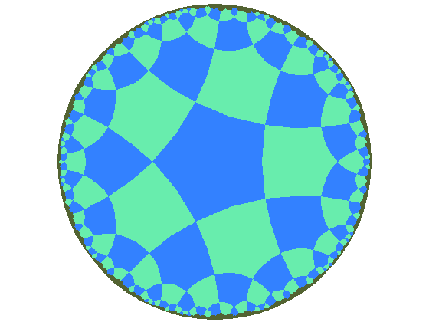
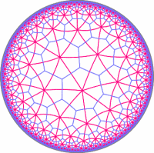
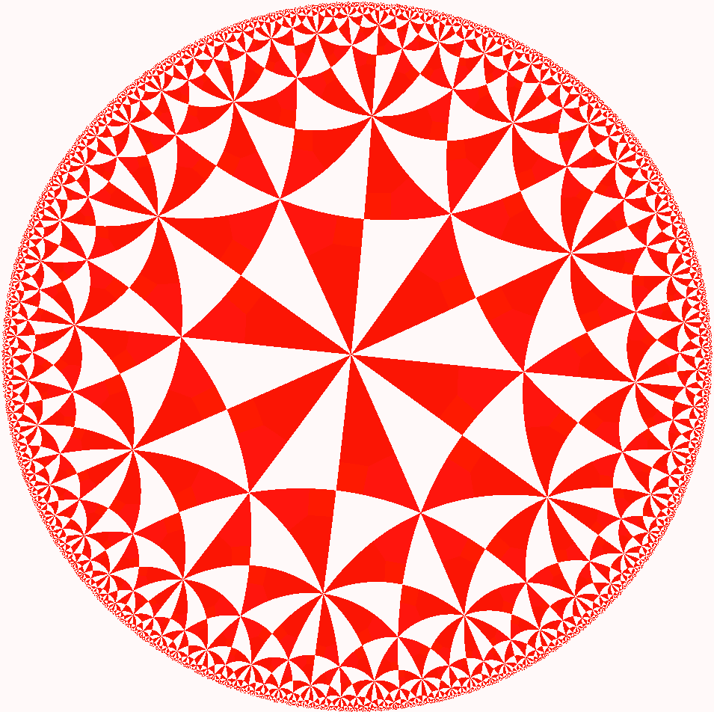
But how many actually exist?
But Euler’s formula only says which values of p and q we can possibly have. It doesn’t say that such a map will actually exist!
To solve this problem requires studying surfaces in a special way. The maps are transformed into tessellations of the hyperbolic plane
Then computers are needed to calculate from the millions of possibilities which ones will actually work!

Slide 22
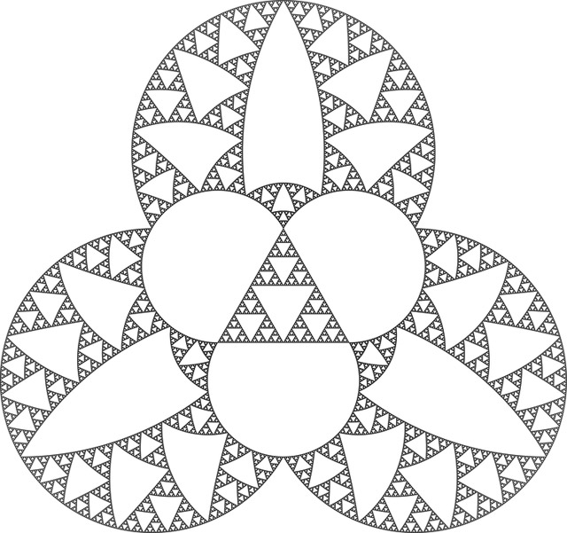
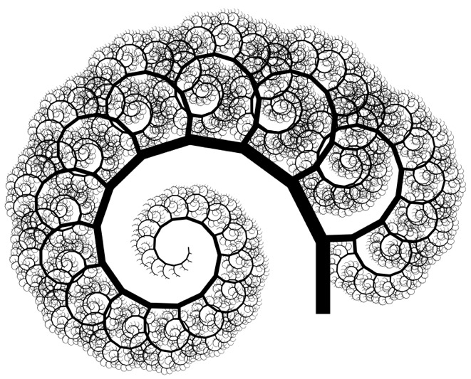
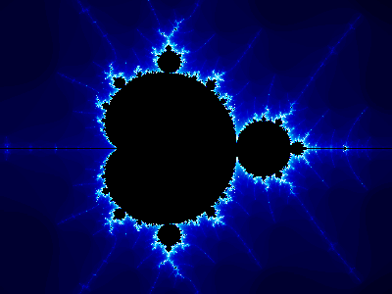
Next time…
How long is the coastline of Great Britain? Sounds a simple question, right, but it’s not actually so easy to answer!
Next week you’ll look at problems like this, and see how it relates to the theory of fractals, special shapes like these.
You’ll see how these shapes are neither 2D nor 3D, but something in between. Studying these fractal dimensions shows that the coastline of Great Britain is actually infinitely long…

Slide 23
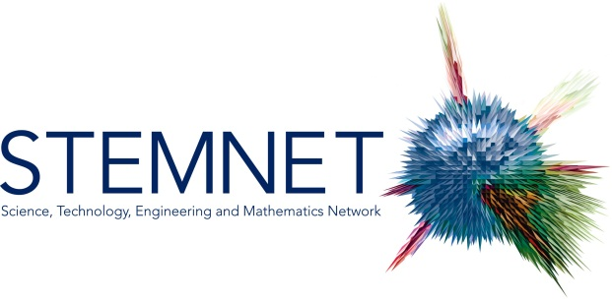
Thanks to
David Martí Pete
email: David.MartiPete@open.ac.uk website: users.mct.open.ac.uk/dmp387
twitter: @davidmartipete
Mairi Walker
email: Mairi.Walker@open.ac.uk website: www.mairiwalker.co.uk
twitter: @mairi_walker

