Slide 1
Fractals everywhere
St Paul’s Geometry Masterclass II

Slide 2
Who are we?
Mairi Walker
Final year maths PhD student at The Open University
Studying links between geometry and numbers
Also interested in the history of maths
David Martí Pete
Second year PhD student at The Open University
Studying complex dynamics

Slide 3
What are we doing?
We have organised a series of workshops to show you what it’s like to study maths at university. We’ve based the themes on aspects of our own research, and some of our favourite topics!
The workshops are:
From polygons to polyhedra and beyond
Fractals everywhere
Mapping the world

Slide 4
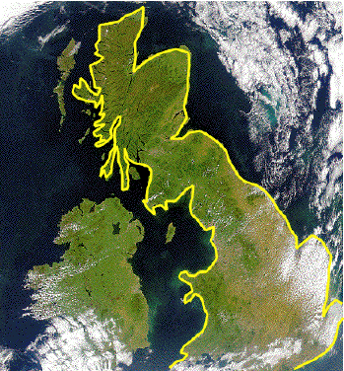
How long is the coastline of Great Britain?
You can measure the length of a coastline using a map and string. Using the map’s scale you can convert the length of the coastline on the map to the actual length of the coastline.
Map scale | Length of string (cm) | Length of coastline (km)
1:26,300,000 | 14.6 | 3829.8
1:11,100,000 | 36.6 | 4062.6
1:5,260,000 | 88.9 | 4676.1
1:4,170,000 | 125 | 5212.5

Slide 5
The coastline paradox
The coastline paradox is the observation that the length of a coastline is ambiguous, or, in mathematical terms, not well-defined; the length of a coastline depends on the scale at which you measure it, and increases without limit as the scale increases.
The coastline paradox happens because coastlines are examples of fractals, mathematical shapes or objects that exhibit a repeating pattern that displays at every scale.

Slide 6
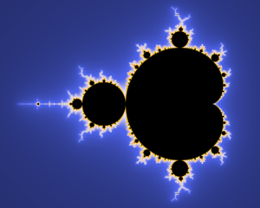
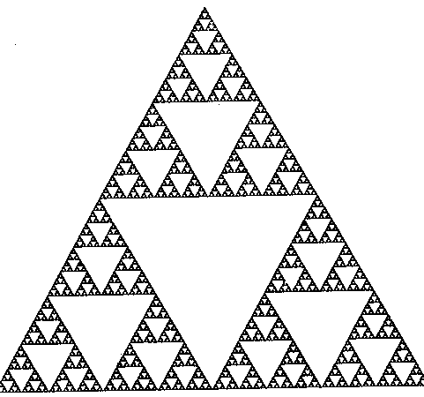
Self-similarity
An object is self-similar if parts of it look sort of like the whole thing. If parts of it look exactly like the whole thing only smaller, then the object is strictly self-similar.
An object has structure at all scales if you can zoom in to any point, infinitely far, and keep finding more and more detail.

Slide 7
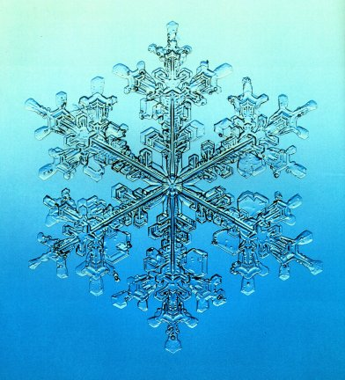
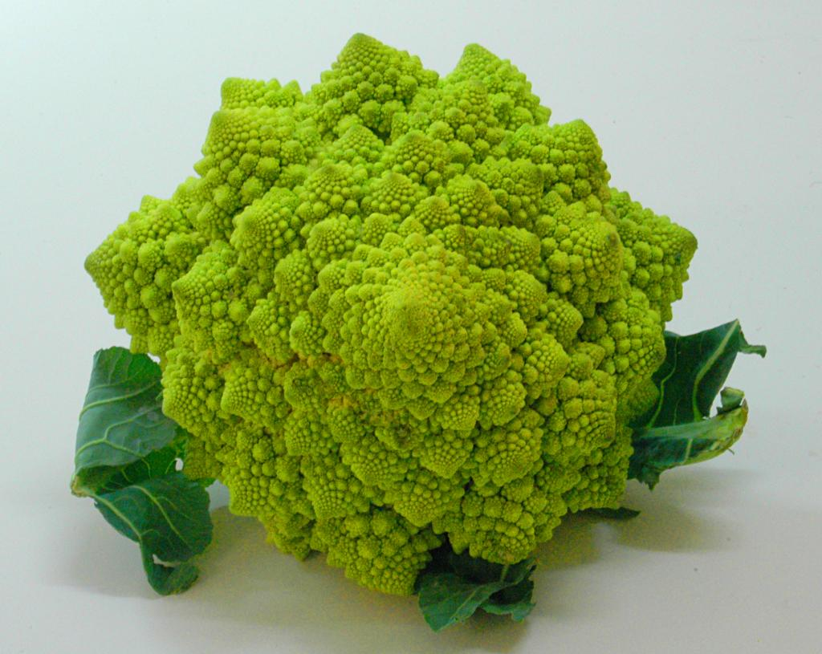
Fractals in nature

Slide 8
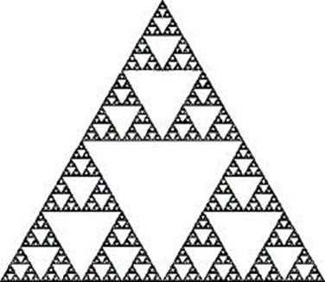
Geometric fractals
They are strictly self-similar!

Slide 9
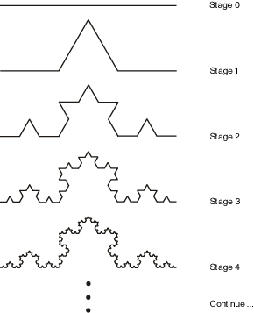
Constructing geometric fractals
They can be created using a recursive rule.
“Draw an equilateral triangle in the middle third of each straight line then remove the base.”

Slide 10
Constructing geometric fractals
“Divide each black square into 9 smaller squares,
and remove the middle one”

Slide 11
Measuring self-similar fractals
How long is this fractal, the von Koch curve?
Fractals have infinitely fine detail so are very difficult to measure!

Slide 12
Measuring self-similar fractals
We can measure a self-similar fractal by measuring each stage of its construction.
The stages get closer and closer to the actual fractal, so their lengths should get closer and closer to the length of the actual fractal.

Slide 13
The length of the von Koch curve
Stage | Number of segments | Length of segments | Total length
1 | $$4$$ | $$\frac{1}{3}$$ | $$\frac{4}{3}$$
2 | $$16=4^{2}$$ | $${\frac{1}{9}=\left(\frac{1}{3}\right)}^{2}$$ | $${\left(\frac{4}{3}\right)}^{2}$$
3 | $$64=4^{3}$$ | $${\frac{1}{27}=\left(\frac{1}{3}\right)}^{3}$$ | $${\left(\frac{4}{3}\right)}^{3}$$
n | $$4^{n}$$ | $${\left(\frac{1}{3}\right)}^{n}$$ | $${\left(\frac{4}{3}\right)}^{n}$$

Slide 14
The length of the von Koch curve
How long is this fractal, the von Koch curve?
It is infinitely long!

Slide 15
Measuring fractals
Funny things can happen when we measure fractals.
The von Koch curve is infinitely long, yet does not stretch infinitely far in any one direction.
The Sierpinski carpet has zero area, yet we can still see it.
Why do fractals have these strange properties?
It is to do with dimension!

Slide 16
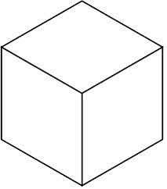
Dimension
Lines have one dimension, planes have two dimensions, and our space has three dimensions.
What dimension might a fractal have?

Slide 17
Fractal dimension
The dimension of a fractal is not generally a whole number!

Slide 18
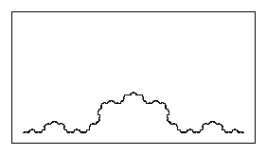
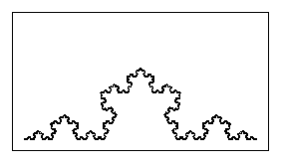
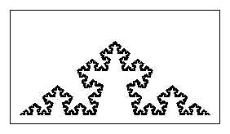
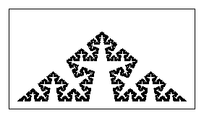
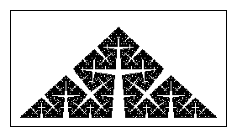
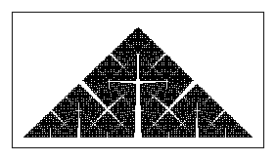
Fractal dimension
The closer the dimension is to two, the more solid the fractal appears.

Slide 19
Relating dimension to measurements
A line is made up of $\frac{1}{r}$ copies of itself scaled by a factor of $r$.
Scale factor $\frac{1}{4}$
4 copies

Slide 20
Relating dimension to measurements
A square is made up of (1/r)² copies of itself scaled by a factor of r.
Scale factor $\frac{1}{4}$
16 copies

Slide 21
Relating dimension to measurements
A line is made up of $\frac{1}{r}$ copies of itself scaled by a factor of $r$.
A square is made up of ${\left(\frac{1}{r}\right)}^{2}$ copies of itself scaled by a factor of $r$.
A cube is made up of ${\left(\frac{1}{r}\right)}^{3}$ copies of itself scaled by a factor of $r$.
We have the formula
$$N={\left(\frac{1}{r}\right)}^{d}.$$

Slide 22
Fractal dimension
$$N={\left(\frac{1}{r}\right)}^{d}.$$
$$r=\frac{1}{2}, N=3$$
What is the dimension? We need to solve the equation for d.

Slide 23
A formula for fractal dimension
$$N={\left(\frac{1}{r}\right)}^{d}.$$
Take logs on both sides:
$$\log\left(N\right)=\log\left({\left(\frac{1}{r}\right)}^{d}\right)=d\log\left(\frac{1}{r}\right).$$
Giving the equation
$$d=\frac{\log\left(N\right)}{\log\left(\frac{1}{r}\right)}.$$

Slide 24
The dimension of the Sierpinski triangle
$$d=\frac{\log\left(N\right)}{\log\left(\frac{1}{r}\right)}$$
$$r=\frac{1}{2}, N=3$$
$$d=\frac{\log\left(3\right)}{\log\left(2\right)}=1.58496…$$

Slide 25
Dimension and measuring
The dimension can tell you a bit about the measurements of a fractal.
If the dimension is less than 1 then the length and area will be 0.
If the dimension is between 1 and 2 then length will be infinite but area will be zero.
If the dimension is bigger than 2 then both length and area will be infinite.
This is how come the Sierpinski triangle has infinite length but zero area!

Slide 26
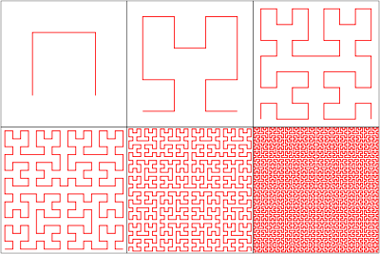
Even more strange!
Peano curves are
able to fill the whole
plane!

Slide 27
How long is the coastline of Great Britain?
The coastline of Great Britain is not a self-similar fractal, so we can’t use our formula to work out its dimension. However, there are other ways of working out the dimension of fractals.
It can be calculated that the dimension of the coastline of Great Britain is around 1.26.
So how long is the coastline of Great Britain? It is infinitely long!

Slide 28
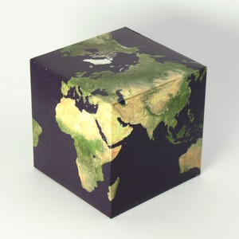
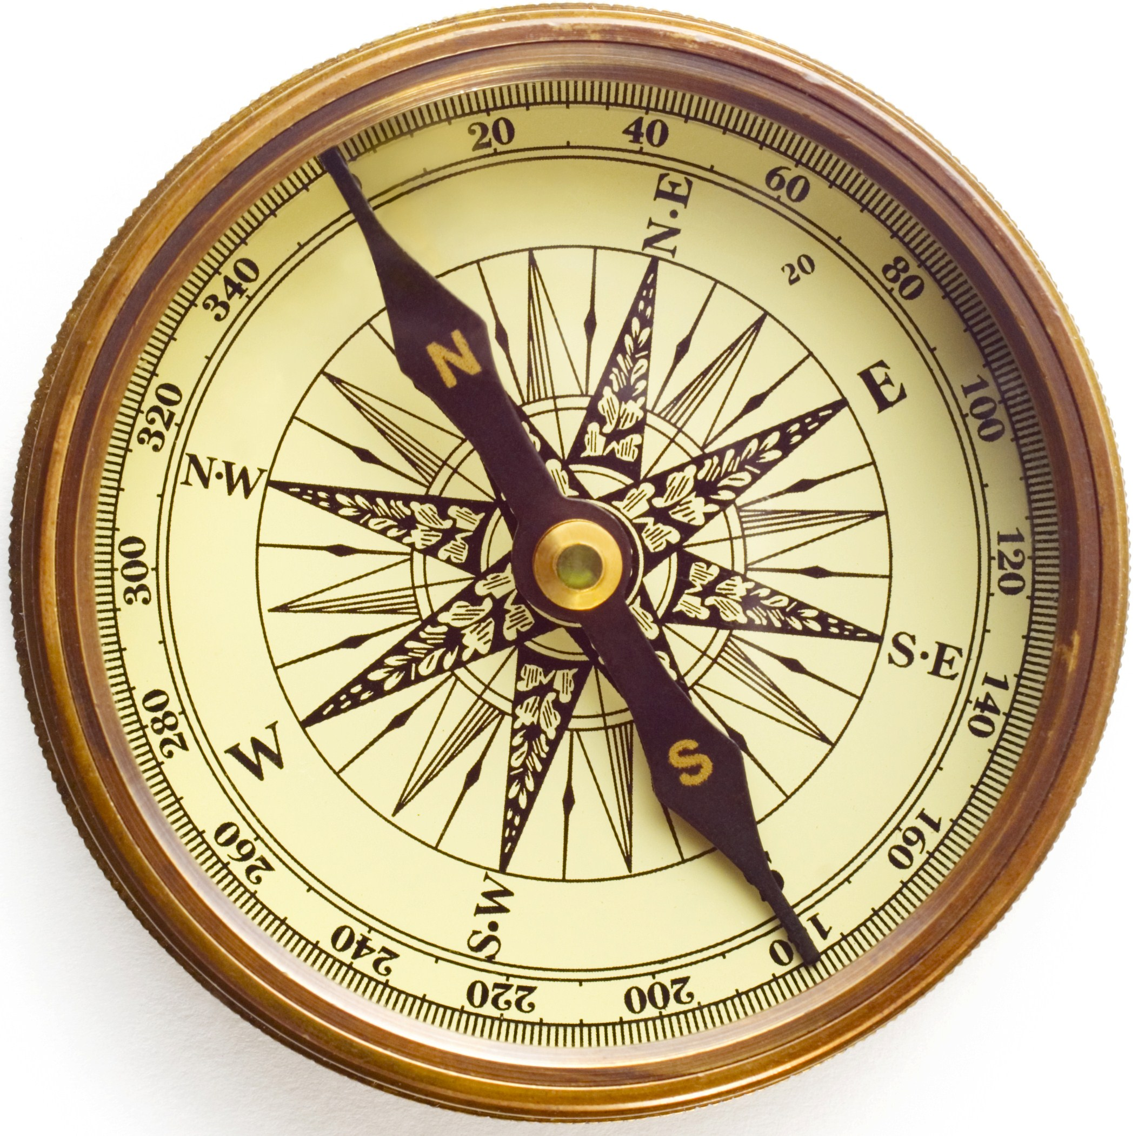
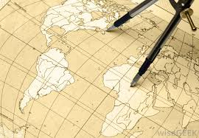
Next time…
How can we make a flat map of the spherical Earth? Are some methods better than others? Why don’t planes fly following straight lines?

Slide 29
Thanks to
email: David.MartiPete@open.ac.uk website: users.mct.open.ac.uk/dmp387
twitter: @davidmartipete
email: Mairi.Walker@open.ac.uk website: www.mairiwalker.co.uk
twitter: @mairi_walker

