Slide 1
Mapping the world
St Paul’s Geometry Masterclass III

Slide 2
Who are we?
Mairi Walker
Final year maths PhD student at The Open University
Studying links between geometry and numbers
Also interested in the history of maths
David Martí Pete
Second year PhD student at The Open University
Studying complex dynamics

Slide 3
What are we doing?
We have organised a series of workshops to show you what it’s like to study maths at university. We’ve based the themes on aspects of our own research, and some of our favourite topics!
The workshops are:
From polygons to polyhedra and beyond
Fractals everywhere
Mapping the world

Slide 4
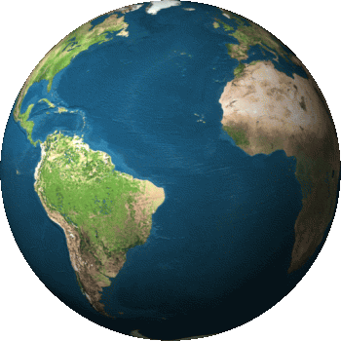
Our world
Today we are going to be looking
at how can we make maps of
the world from the mathematical
point of view!

Slide 5
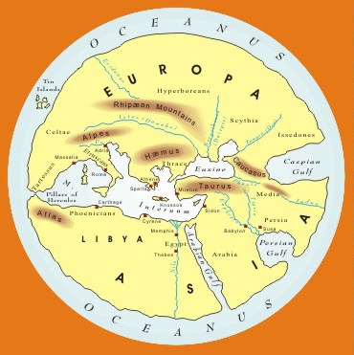
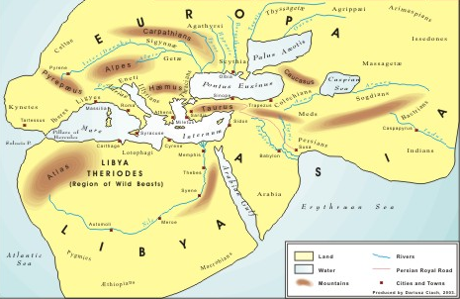
The first maps
Until around 500 BC
the Earth was believed to be flat!

Slide 6
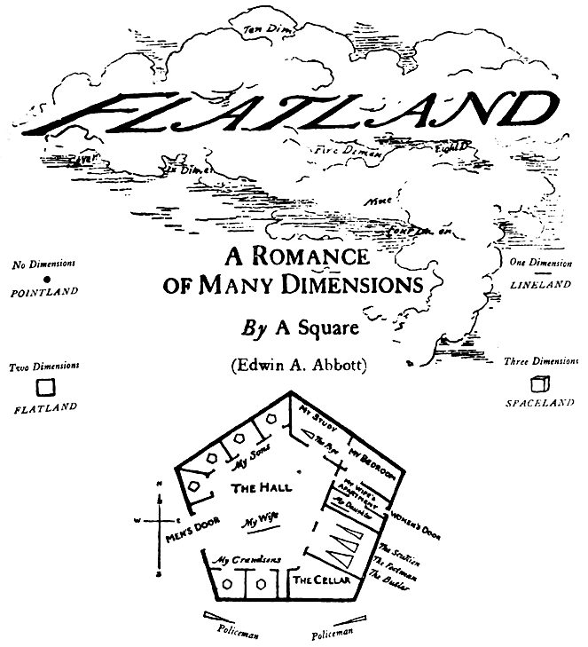
Flatland
How would it be
to live in a
2-dimensional world? Book
“Flatland: A Romance
of Many Dimensions” by Edwin A. Abbott

Slide 7
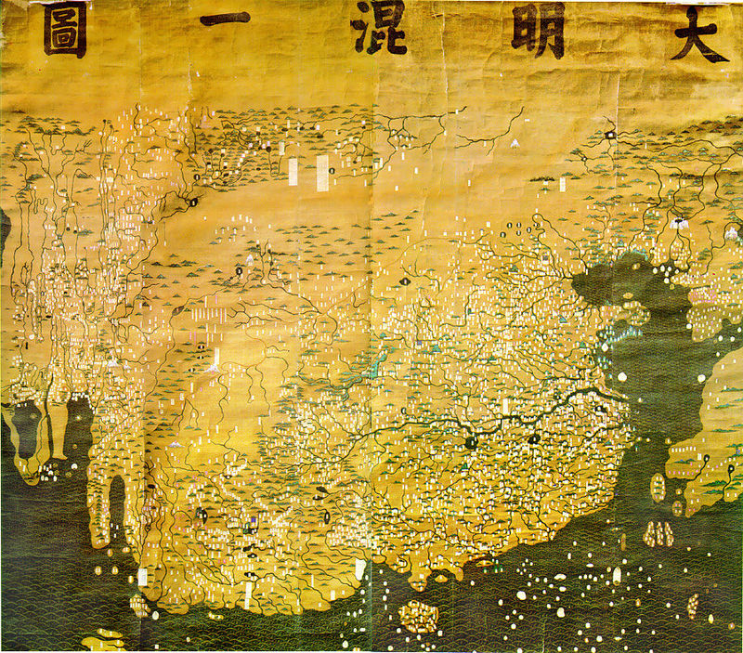
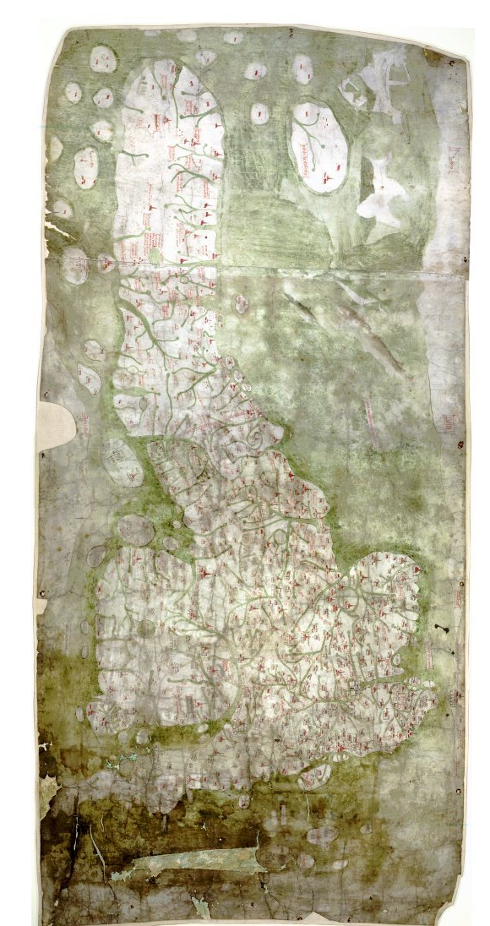
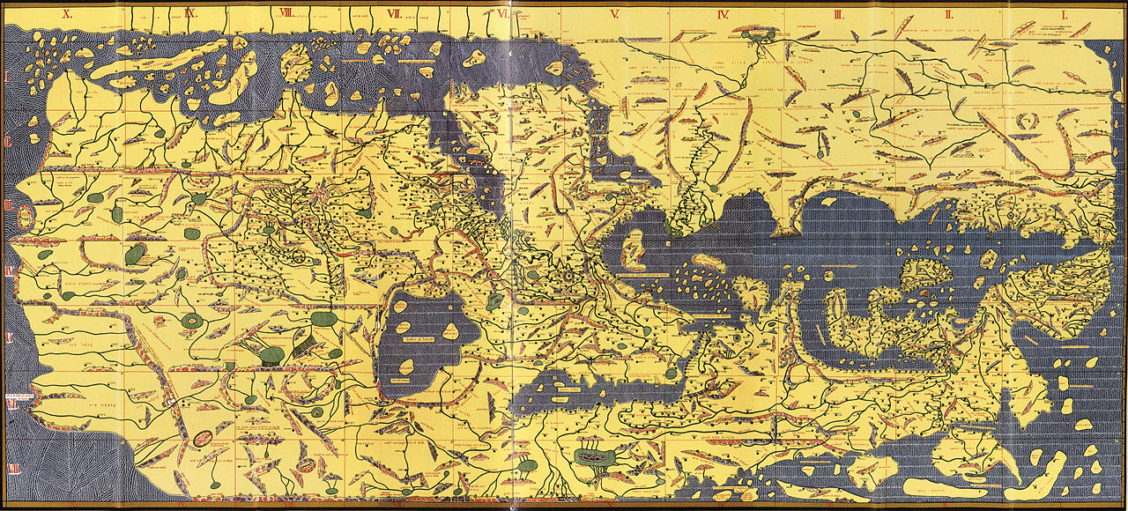
Further developments…

Slide 8
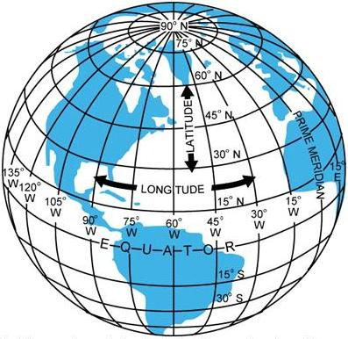
Coordinates
A point on the surface of the Earth can be
determined by two numbers (angles):
Longitude: from 0º to 180º E/W
Latitude: from 0º to 90º N/S
Parallels have constant latitude
The 0º parallel is the equator
Meridians have constant longitude
The 0º meridian passes through Greenwich

Slide 9
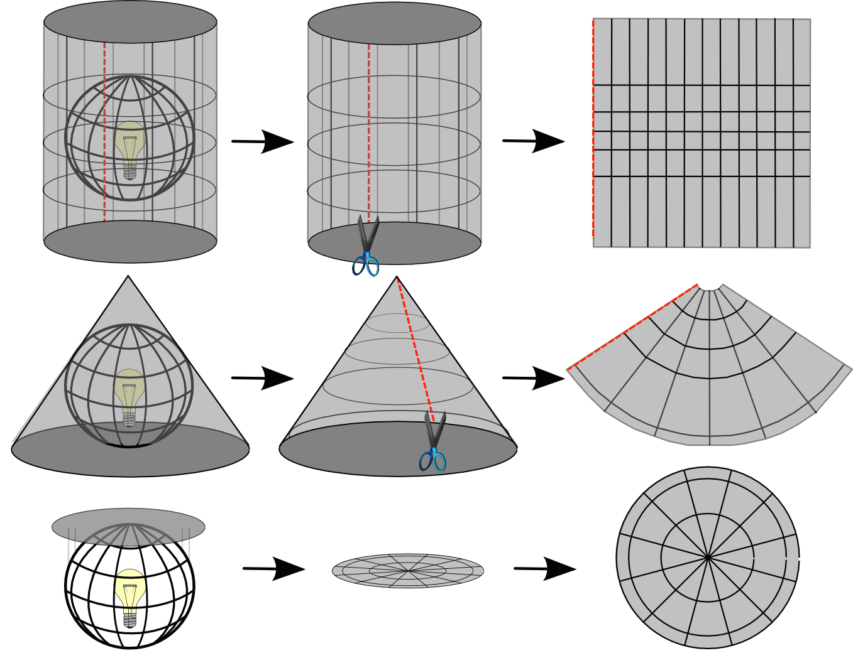
Maps are projections
A projection is any mathematical function transforming coordinates
from the curved surface (our sphere) to the plane.
How can we
achieve this?

Slide 10
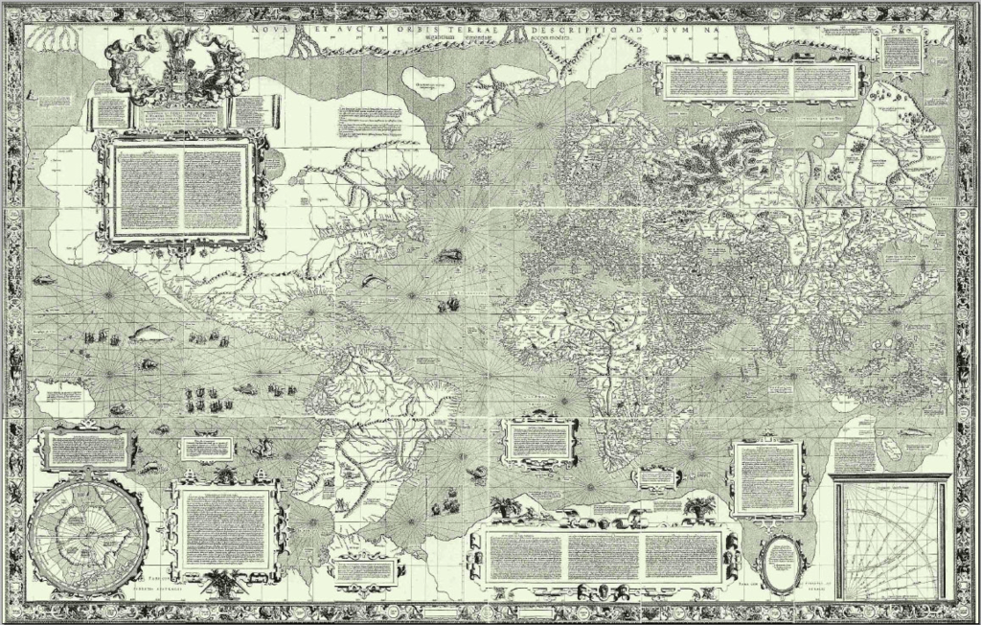
Mercator’s world map (1569)

Slide 11
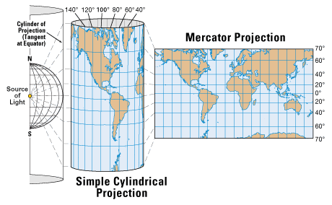
How is it made?

Slide 12
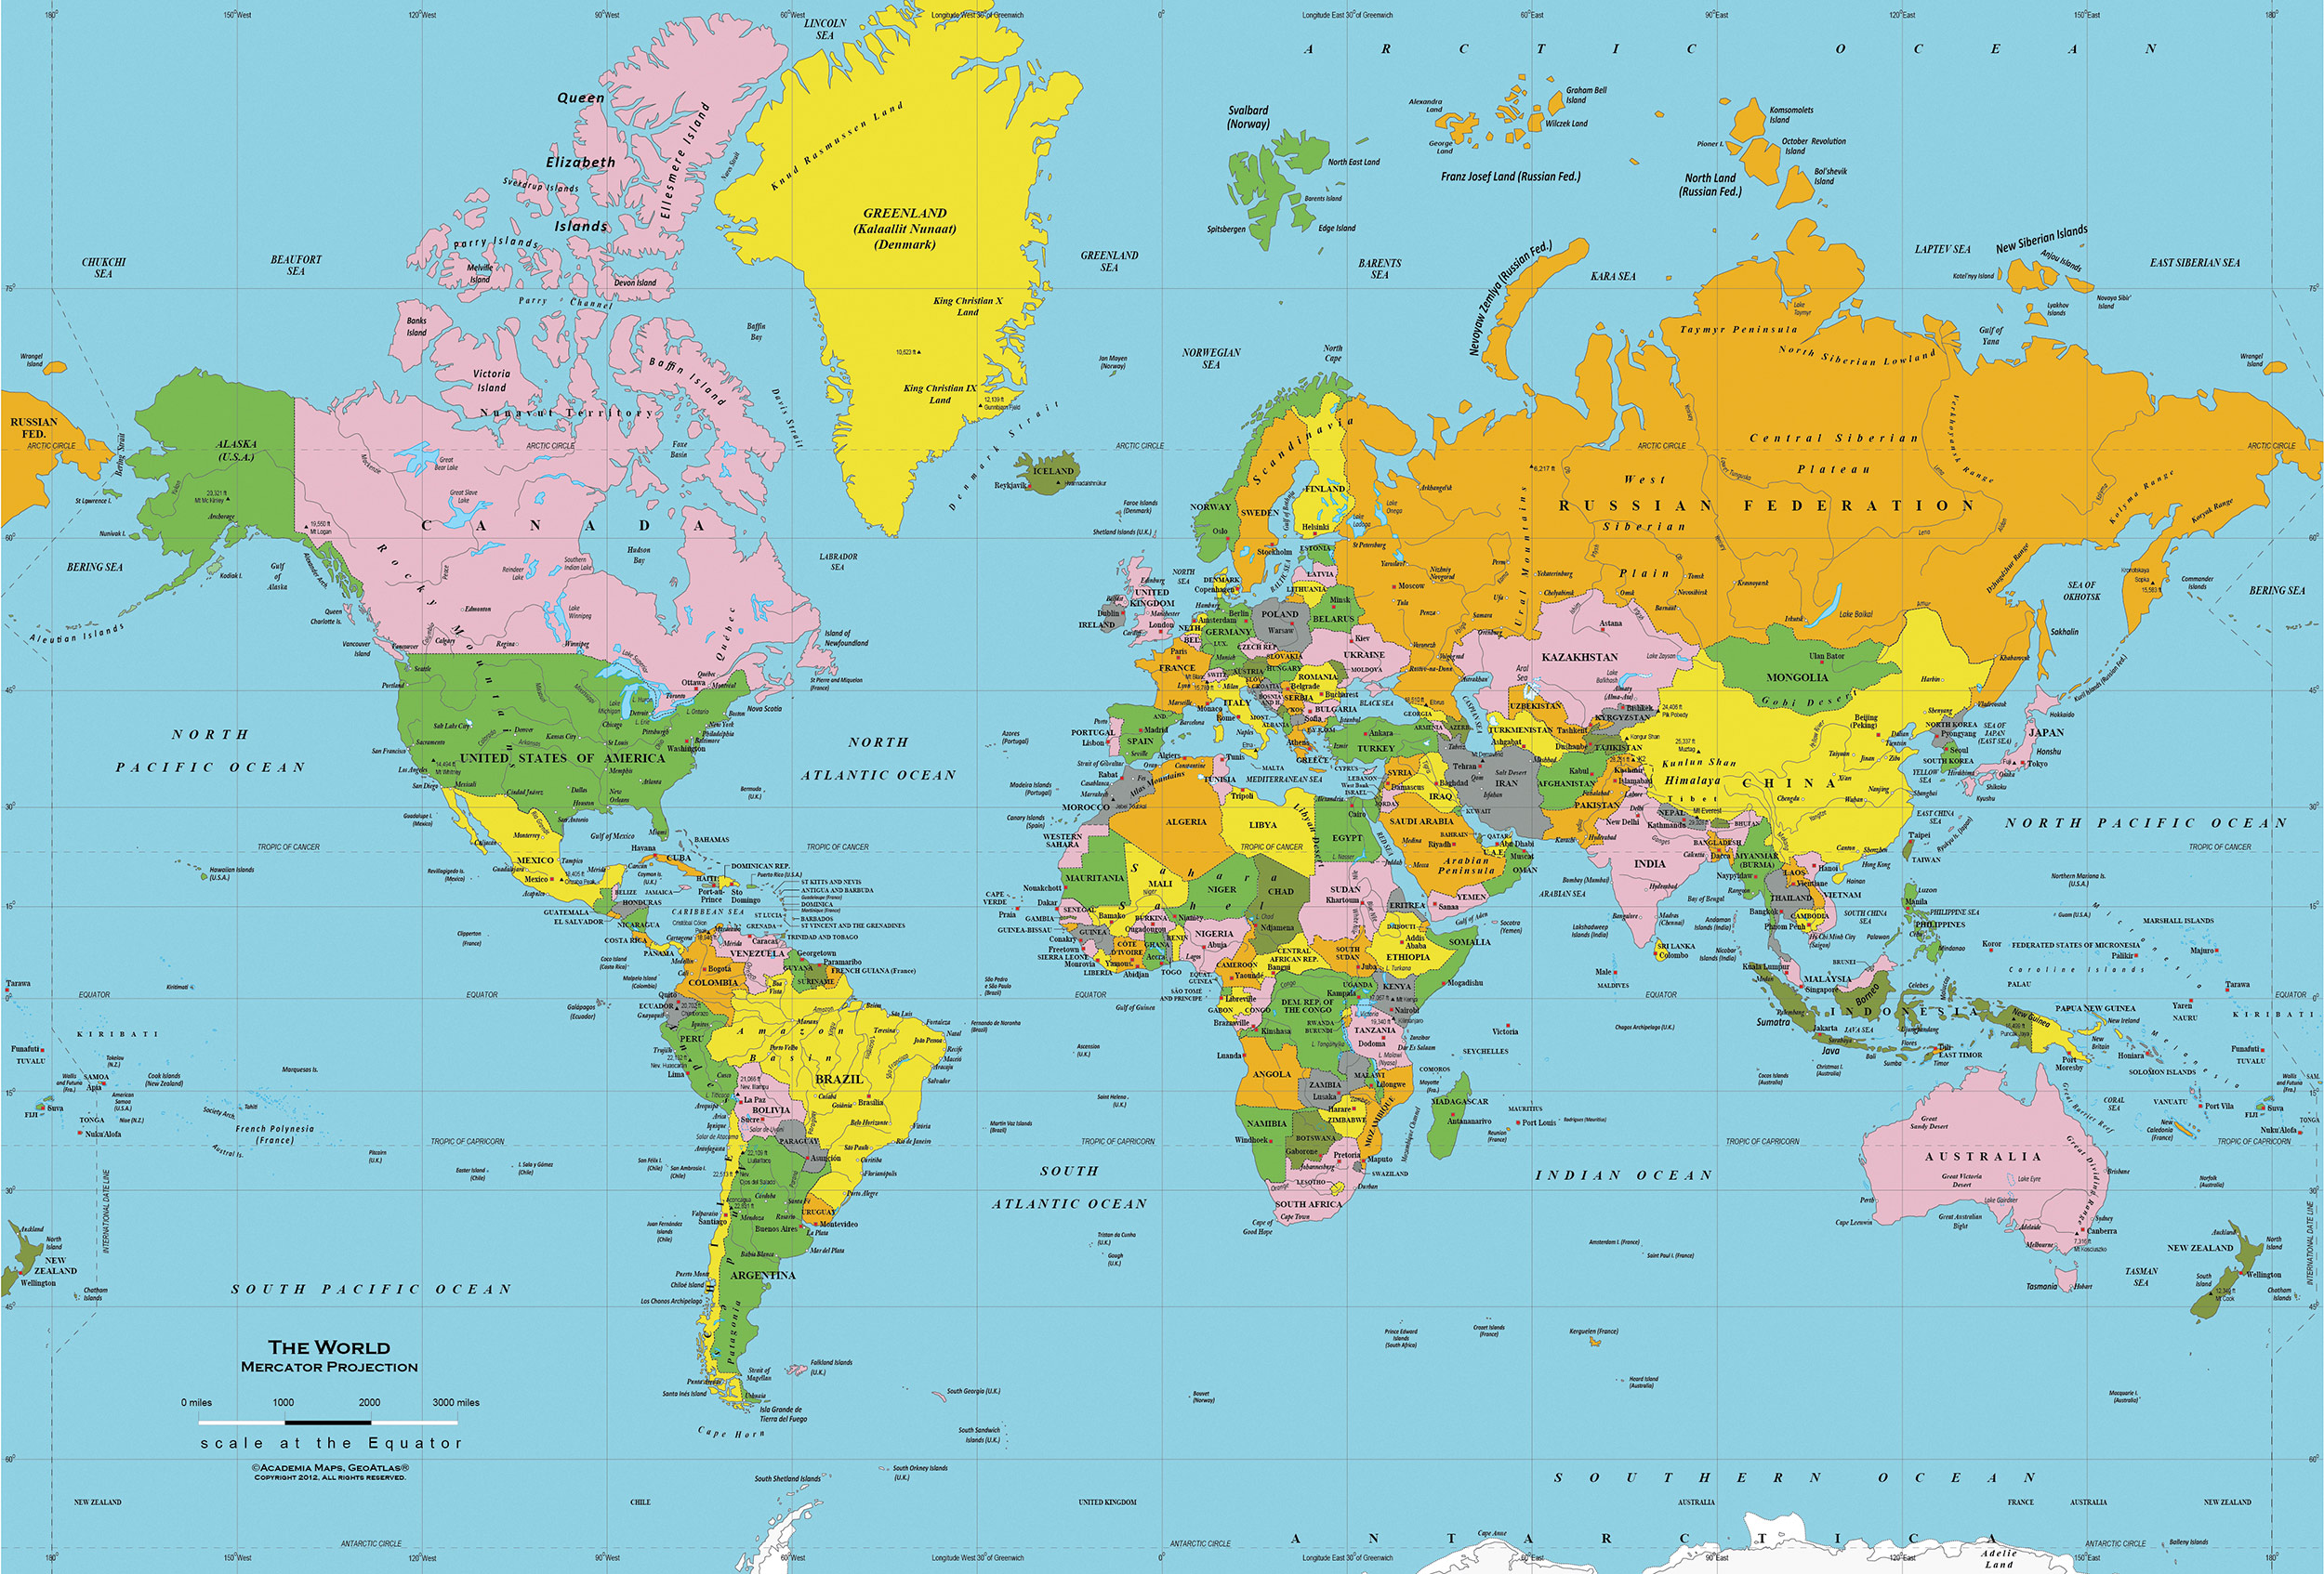
Mercator’s projection

Slide 13
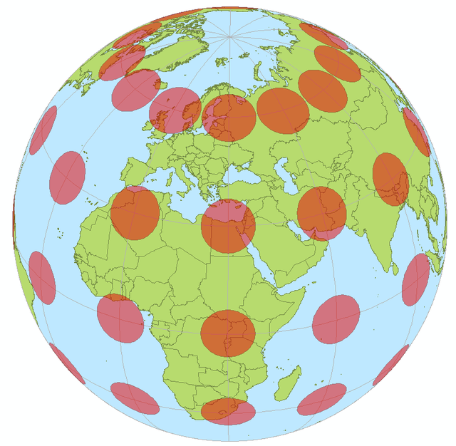
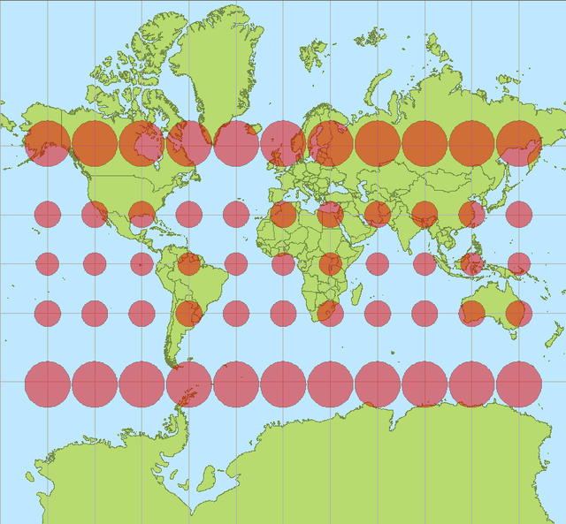
How to measure the distortion?
Mathematicians use a tool called Tissot’s indicatrix!

Slide 14
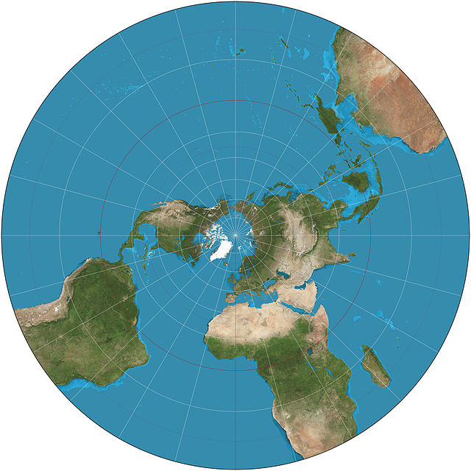
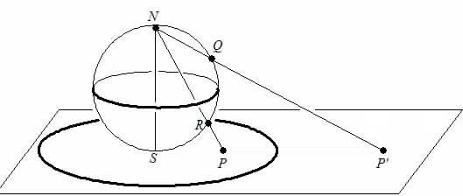
Stereographic projection
This is an example of another conformal projection,
this means that it maps circles to circles
or, in other words, it preserves angles

Slide 15
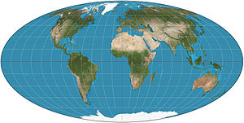
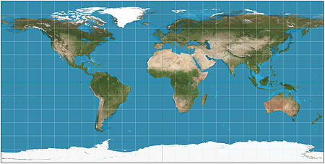
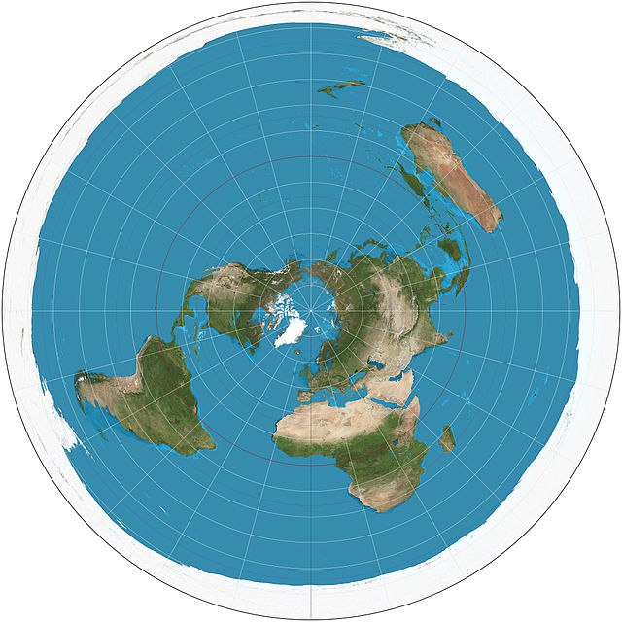
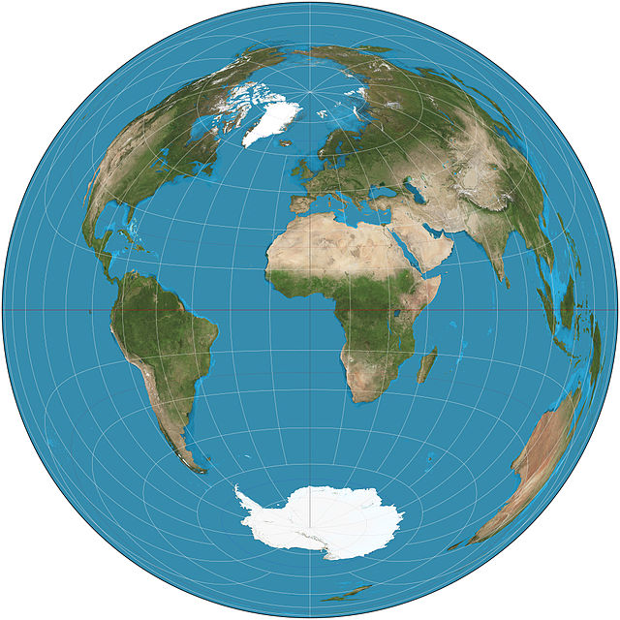
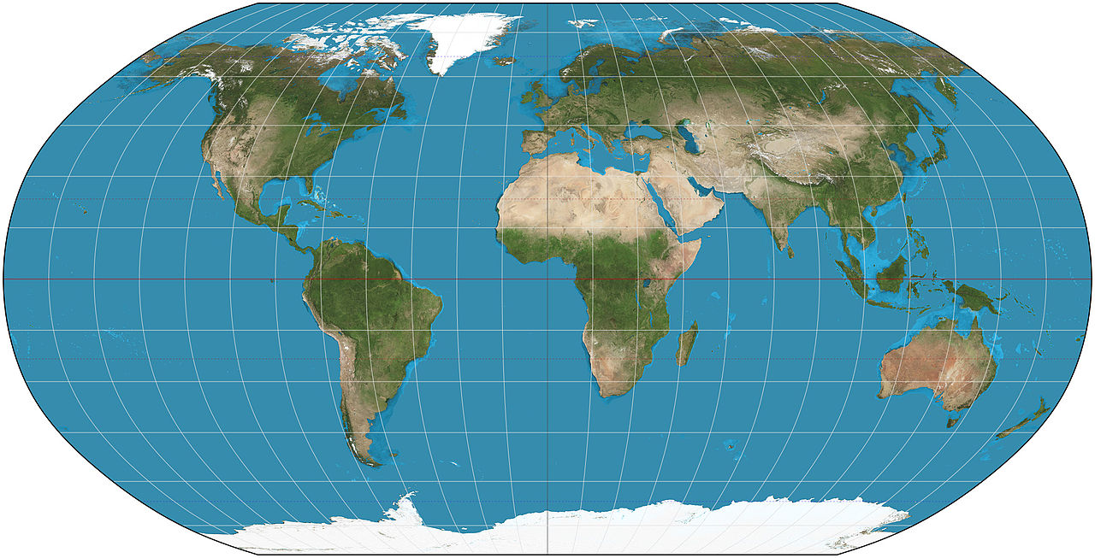
Other projections

Slide 16
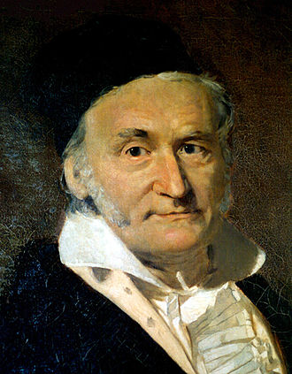
Gauss’s Theorema Egregium
If a surface is developed upon any other surface whatever,
the measure of curvature at each point remains unchanged!
This implies that maps cannot preserve both area and angles at the same time!

Slide 17
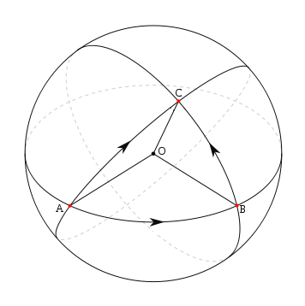
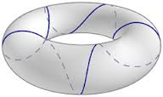
Geodesics
A geodesic is the shortest path to go from a point A to a point B on a mathematical surface!
In the case of a sphere,
geodesics correspond to great circles
(those who have maximum diameter)

Slide 18
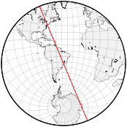
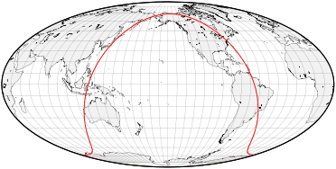
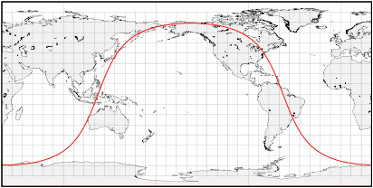
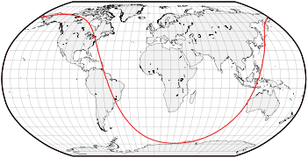
How do they look on a map?

Slide 19
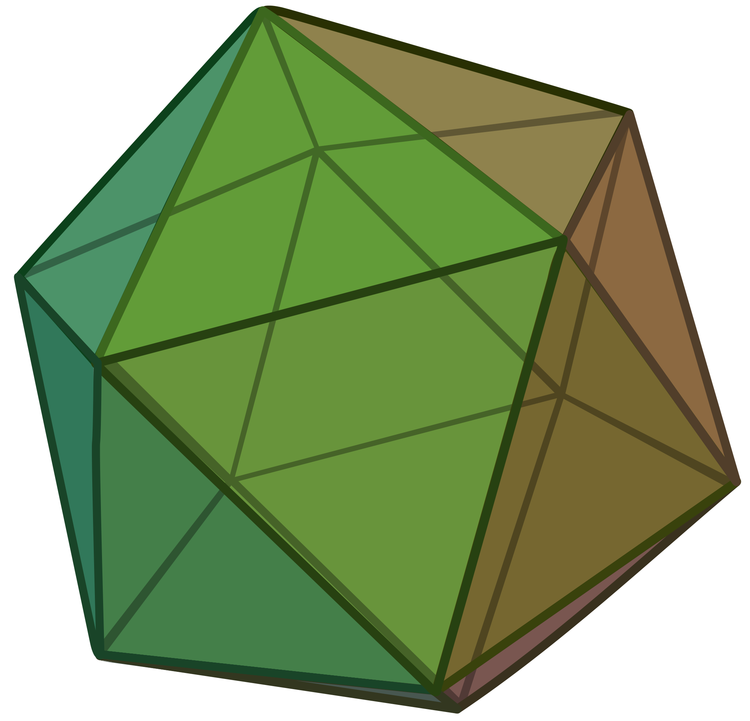
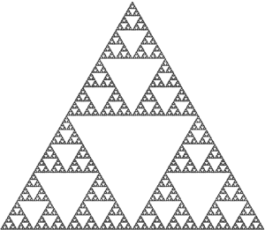
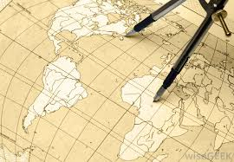
That’s all folks!
You will find all the material and more links to related things in our websites:
http://users.mct.open.ac.uk/dmp387/eng/outreach.html http://www.mairiwalker.co.uk

Slide 20
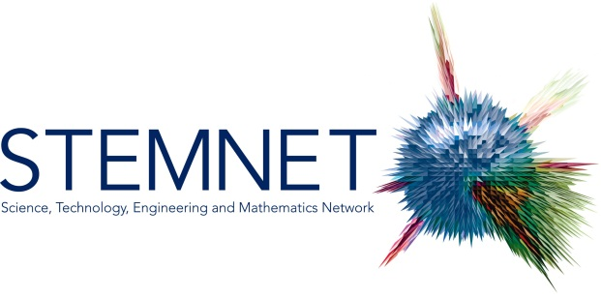
Thanks to
David Martí Pete
email: David.MartiPete@open.ac.uk website: users.mct.open.ac.uk/dmp387
twitter: @davidmartipete
Mairi Walker
email: Mairi.Walker@open.ac.uk website: www.mairiwalker.co.uk
twitter: @mairi_walker

